Slide 1



A COMPARISON OF TRIPS TO SCHOOLS IN SUBURBAN BANGKOK
Nattapol PIYAEISARAKUL
King Mongkut’s University of Technology Thonburi
and
Associate Professor Viroat SRISURAPANON
King Mongkut’s University of Technology Thonburi

Slide 2

TOPICS
INTRODUCTION
METHODOLOGY
SCHOOL LOCATION
SCHOOL BUS MANAGEMENT
CHARACTERISTICS OF PARENTS
RESULTS

Slide 3
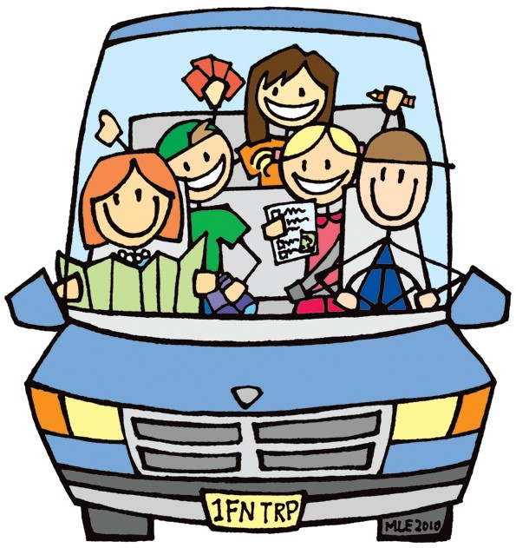

INTRODUCTION
In Bangkok, the private car is favored more than other transportation modes; it is the most favorite method to send or pick up students from home to school and vice versa (Dissanayake & Morikawa, 2010). However, private cars are the main reason for traffic congestion around schools such as blockage of streets and areas around schools (La Vigne, 2007).

Slide 4
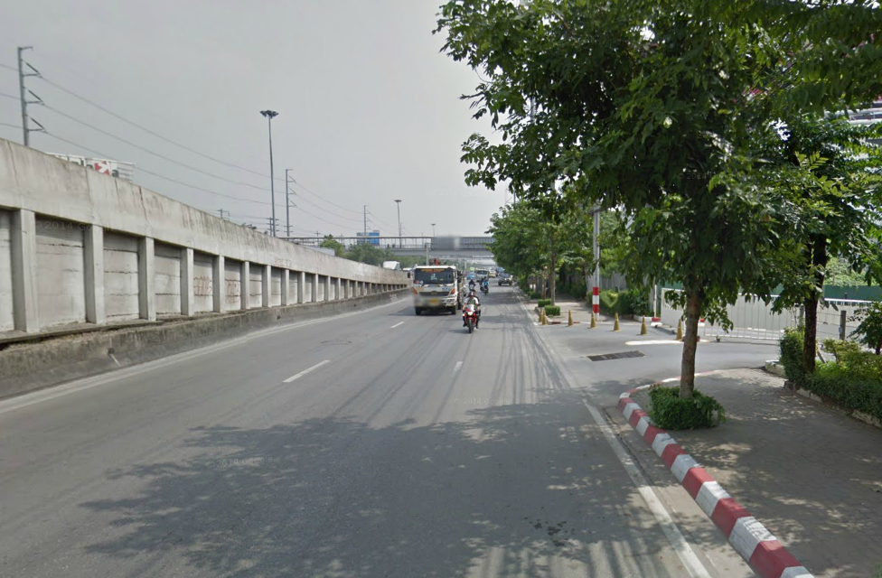
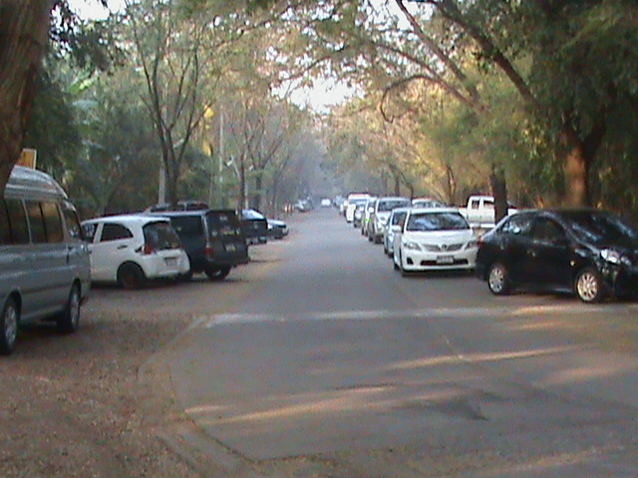
INTRODUCTION
Parents who have high incomes choose private schools or selected schools for their children to attend, and they tend to drive their children by themselves in the morning and park their cars to wait for those students to finish class and get them home in the evening. That is the reason of traffic congestion around schools (Khan et al., 2011).
School A
School B

Slide 5
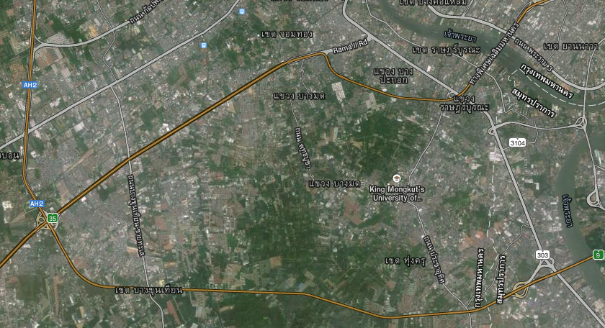
INTRODUCTION
School A is an alternative school and is located in suburban Bangkhuntian District on Rama II Road, it close to Rama II Road.
School B is an alternative school and is located in suburban Bangkhuntian District on Rama II Road, and the distance from the school to Rama II Road is about 2 km.
A
B

Slide 6
INTRODUCTION
School B has the same problems of traffic congestion like other private schools. About 90.22% of the parents of School B decide to send their children to school by private car and only 3.78% choose the school bus (Srisurapanon et al., 2014).
School B

Slide 7
INTRODUCTION
However, if we change the location of schools, do we observe the same characteristics of parent behavior?
If the results are similar to School B, then suburban schools display similar characteristics.
If the results are not similar, it shows that suburban schools do not exhibit similar characteristics, and the characteristics of parents are influenced by other factors. That is the interesting reason why we should study this phenomenon.

Slide 8

INTRODUCTION
The objectives of this study are to conduct a comparison of two schools and find the reasons. If we change our focus from School B to another school which is in the same location or same district, and the type of school is private school or selected school similar to School B, is the percentage of parents who decide to drive to school similar to School B or not?

Slide 9
INTERESTING ISSUES TO ANALYZE
Issues for comparison
School location, number of students/teacher
Methods of traveling to school
Mode selection to school
School bus provided
Factors influencing the decision of parents
Composition of school bus systems
School bus management
Degree of importance of the management

Slide 10
METHODOLOGY
OBSERVATION BY SENDING QUESTIONNAIRES TO PARENTS
Mode
Trip length
Trip cost
Arrival time
Perception or attitude of traffic

Slide 11
METHODOLOGY
INTERVIEW
General issues e.g., starting time, types of school buses, number of school buses
Tuition fees/entrance fees
Bus fare system
Management of school bus

Slide 12
METHODOLOGY
OBSERVATION OF PHYSICAL FACILITIES AROUND SCHOOLS
Sidewalks, public transportation, parking
School bus operation
Use of facilities in school bus e.g., safety belts

Slide 13
SCHOOL LOCATION
SCHOOL A
School A is an alternative school and is located in suburban Bangkhuntian District
590 students and is divided into three subsections
Kindergarten students attend class in the morning before 09:00 AM.
Primary students attend class starting at 08:10 AM.
All levels of School A have about 20 students per class room.
SCHOOL B
School B is an alternative school and is located in suburban Bangkhuntian District.
1,192 students and is divided into three subsections — Kindergarten Level 1 - Level 3, Primary Level 1 - Level 6, Junior High School and Senior High School.
Kindergarten students attend class in the morning before 0900.
Primary school, junior high school and senior high school students attend class in the morning at 0750.
All levels of School A have a student population of about 25 students per classroom.

Slide 14
SCHOOL LOCATION
SIDEWALKS AROUND SCHOOLS :
The sidewalks of School A are wide and convenient
School A
The sidewalk of School B is not wide (narrow path) because it is controlled by the roadway. And they need to share the road with vehicles and that is harmful for children.
School B

Slide 15

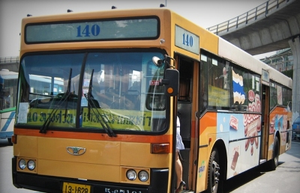
SCHOOL LOCATION
TYPES OF PUBLIC TRANSPORT:
NO. | TYPES | ROUTES
1 | Bus (BMTA) | No. 17, 68, 76, 85, 105, 140, 141, 142, 147, 169, 172, 173, 529, 558, 720
2 | Van | - Ramkhamhaeng University - Central Plaza Ladprao - MBK Center - Central Plaza Pinklao
School A has varied types of public transport
School B is dissimilar to School A because School B doesn’t have any public transport; only taxis or motorcycles support travel to and from the school.

Slide 16
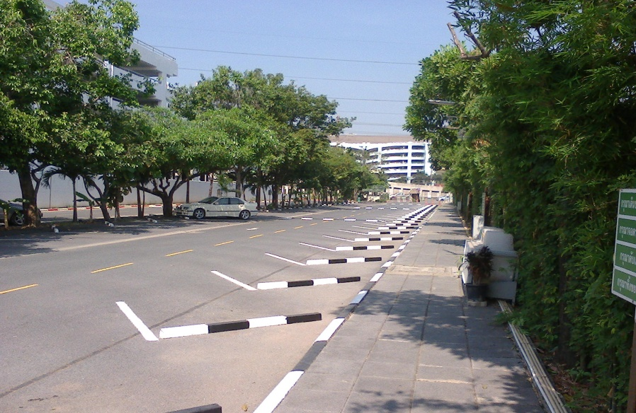
SCHOOL LOCATION
SCHOOL PARKING:
School A has about 140 parking spaces.. It is found that 75.76% of parents drive private cars to school.
School A Parking
School B has a total parking area limit of about 210 spaces. However, parents from about 90%, drive private cars to school
School B Parking

Slide 17
SCHOOL BUS MANAGEMENT
SCHOOL BUS SERVICE TIME:
School A buses, morning delivery only one trip per direction.
in evening, the delivery is two trips per direction.
The first trips are for groups of pre-kindergarten and kindergarten students who finish class at 2.50 p.m.,
and the second trips are for groups of primary school students who early than primary school at 03.50 p.m.
School B buses do deliveries only one trip per direction both in the morning and in the evening,
and kindergartens finish class early and must wait for primary school students.

Slide 18
SCHOOL BUS MANAGEMENT
SCHOOL BUS FARES:
SCHOOL A
For the round trips, the rates start at 0-5 km. and parents pay 1,300 baht. The price range between 1,300–3,800 baht.
For the one way trips, the rates start at 0-5 km. for which parents pay 800 baht. The price range between 800–2,300 baht.
SCHOOL B
For the round trips, based on distances, but no rates of distance are specified, and start at approximately 2,800 baht. The range of fares between 2,800–3,800 baht.
For the one way trips, has no rates of distance and the fares are not clear, it appears to start up at approximately 2,500 baht. The rates increase based on distances to school.

Slide 19
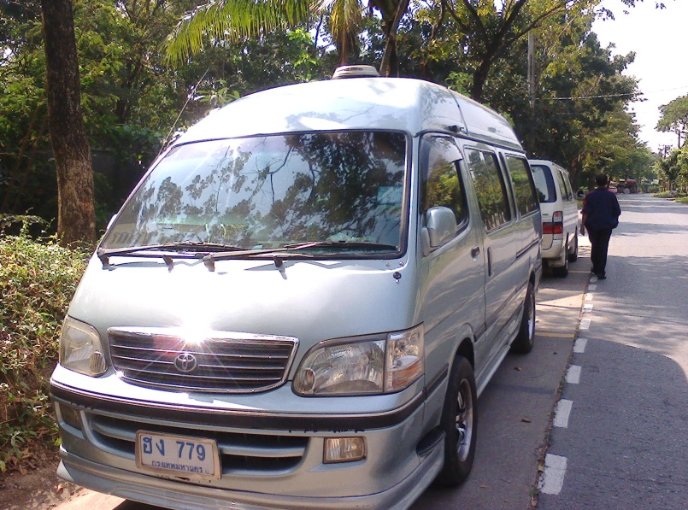
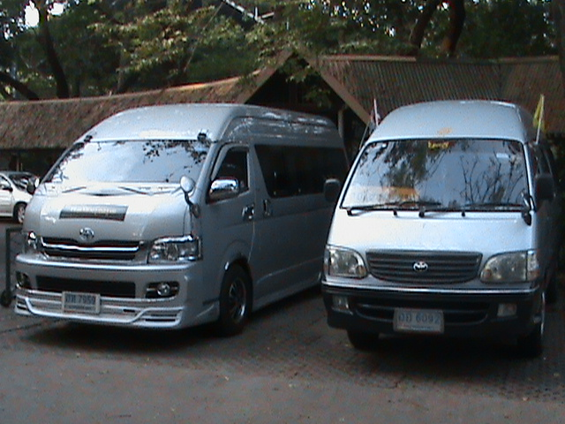
SCHOOL BUS MANAGEMENT
SCHOOL BUS ACCESSORY : SCHOOL A and SCHOOL B
The accessories of both School A and School B buses include seat belts and air conditioning. The specification of the student/seat ratio in a school bus is 1 seat per student. The capacity of a school bus is 14 seats — 12 seats for students.

Slide 20
SCHOOL BUS MANAGEMENT
SCHOOL BUS OPERATION
School A bus operation refers to school bus factors e.g., the driver is an outsider or a private contractor and is not a member of the school staff. The assistant is a member of the school staff and reports to the vehicle division every day the number of students who use the school bus
School B bus operation refers to school bus factors e.g., the driver is an outsider or a private contractor and is not a member of the school staff. The assistant is an outsider, not working at the school. Sometimes, the assistant is absent, so the drivers must take care of additional children themselves

Slide 21
SCHOOL BUS MANAGEMENT
SCHOOL BUS OPERATION
School A Bus Operations
School B Bus Operations

Slide 22
DATA COLLECTION
Level | School A |  | School B
 | Questionnaires |  | Questionnaires
 | Sent | Received | Sent | Received
Kindergarten | 494 | 389 | 279 | 195
Primary school | 89 | 71 | 320 | 219
Secondary school | - | - | 226 | 36
TOTAL | 583 | 460 (78.90%. ) | 825 | 450 (54.54%)

Slide 23
TRAVEL BEHAVIOR
Approximately 75.76% of the School A drive private cars to school in the morning, while 15.50% transport their children on a school bus,
School A
Approximately 90.22% of the School B drive private cars to school in the morning, while 3.78% have their children take a school bus
School B

Slide 24
Modes and Number of Students
School A it is found that most parents, approximately 48% of respondents, have 1 student who goes to school by private car,
School A
School B, It is found that most parents who have 1 student, approximately 50% of respondents, take their child to school by private car,
School B

Slide 25
Activity after Transporting Children
From the analysis of School A, it is observed that 43% of respondents return home after dropping off their children to school, and 42% continue on to work.
School A
From the analysis of School B, it is observed that 63% continue on to work, and 27% of respondents come back home.
School B

Slide 26
Reasons why parents drive their children to School
From the School A data, it is observed that 41% of respondents choose driving to school due to the reasons relating to school bus issues. This is close to half of the total number of reasons and shows that the probability of their children using the school bus if the changing school bus system. While the School B data shows that 37% of respondents do so because of the reasons relating to school bus factors.
School A
School B

Slide 27
Travel Cost to School
Most of the School A parents who travel to school must spend between 51-100 baht, while most of the School B parents who travel to school must spend money in the same range
School A
School B

Slide 28
TRAFFIC DATA
From the questionnaire data inquiring about traffic being a problem in the morning related to sending students to School A, it is found that all respondents who go to school by private cars don’t think traffic congestion is a problem.
School A
transporting students to school B, it is found that 33% of respondents who go to school by private cars think traffic congestion is a problem between 7:31 a.m. and 8:00 a.m., and 10% of the respondents who go to school by private cars think traffic is problematic between 8:01 a.m. and 8:30 a.m.,
School B

Slide 29
TRAFFIC DATA
From the analysis of School A data, it is observed that 42% of respondents believed school buses can reduce traffic congestion around school.
School A
From the analysis of School B data, it is observed that 33% believed shuttle buses can reduce traffic congestion around school.
School B

Slide 30
RESULTS
School A data found that 75.76% of households drive private cars to school, and the reasons why parents drive to school are,
firstly, an inappropriate school bus system;
secondly, a desire to stay closer to their children;
thirdly, living near the school.
School B data found that 90% of households drive private cars to school, and the reasons why students are driven to school by their parents are,
firstly, the convenience of ride-sharing with their parents as a household trip; secondly, an inappropriate school bus system
thirdly, the desire for parents to stay closer to their children.
It is notable that several parents of both schools drive private cars.

Slide 31
RESULTS
School bus management
School A parents are interested in using the school bus, a proportion equal to 15.50% which is greater than the 3.78% of School B parents.
It shows that management of School A buses is more efficient than that of School B buses in terms of the following factors:
Rates of School A buses are based on real distances,
Assistants of School A buses are school staff.
incentives per month paid to drivers which makes it an attractive proposition to drive well.
Parents must of School A pay money directly to School or transfer to bank account.

Slide 32
RESULTS
The school bus fares of a one-way trip and round trips
School A is calculated based on distances,
School B calculates fares based on distances, no rates of distance are stated and not clear.
This shows that the method to calculate fares of School A is greater than School B that similar the fares of round trips.

Slide 33

RESULTS
The physical data
School A is located in an arterial road, the location is not in the same direction as parents’ workplaces, and it can support high traffic volume in peak hours.
School B is sited on a local road, the location is conveniently in the same direction as the workplaces of some parents, and there are traffic jams in morning peak hours.
The location of School A is better than that of School B.

Slide 34

RESULTS
The traffic data,
most parents of School A think traffic congestion isn’t a problem around school,
while most parents of School B think the traffic congestion is a problem. Regardless, 90% of them still drive to school
It shows that a different perception exists about traffic congestion around these two schools despite School A and School B being located in the same district.

Slide 35


CONCLUSION
The results indicate that parents’ decision to use school bus management for their children’s transportation to school includes school bus service time, school bus fares, and school bus operation. Further work would be interesting and is recommended to construct the logit model for School A and use ArcGIS to analysis household locations.

